Slide 1
World Happiness Report
Presented by : Nirmal Joy
Last updated : February 2nd 2022

Slide 2

Presentation Outline
World Happiness
Data summary
Purpose of Statement
Tell the Story
Conclusion

Slide 3
About the Data
The World Happiness Report is a publication of the National Sustainable Development Solutions Network. It contains articles and rankings of national happiness, based on respondent ratings of their own lives, which the report also correlates with various (quality of) life factors.
This Dataset contains Happiness Rank, Happiness Sore , Economy , family, freedom, generosity, health of each country
In this dataset of World happiness report , I had taken the 2015 dataset for analyze of the happiness report
This analysis based on the 2015 dataset of world happiness report

Slide 4
What are we talking about?

Slide 5
Objective
Identify is there any geographic , demographic factors that contribute countries into happier life

Slide 6
Present Data

Slide 7
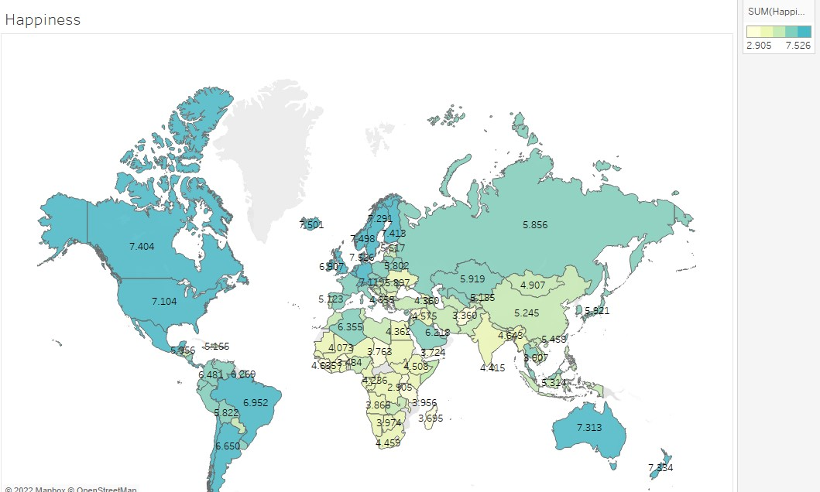
Geographic

Slide 9
Geographic
Happiness Score

Slide 10
Geographic
Happiness Score
Happiness Score varies by country
Little correlation between geographic location and happiness score
Geographic location is not a best indicator of Happiness

Slide 11
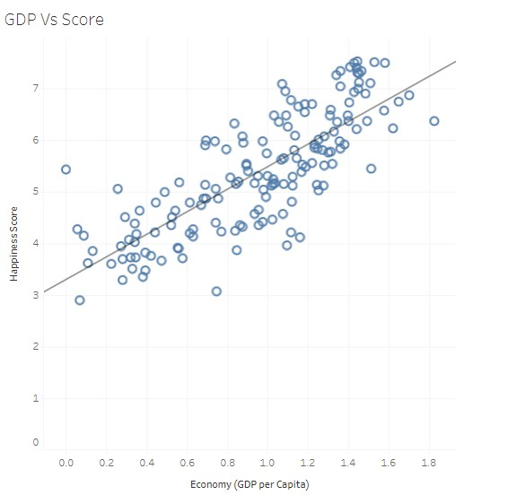
GDP vs Happiness
0.80
Correlation Coefficient
Strong positive Correlation between Gross domestic product (GDP) and Happiness Score
Richest Countries have higher Happiness Score
When Economy Increases Happiness of the country increases

Slide 12
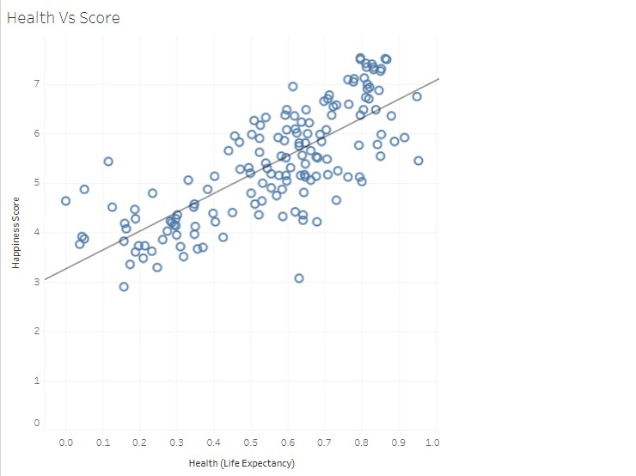
Health Vs Score
0.75
Correlation coefficient
Positive correlation between Health and Happiness Score
Healthy countries have the higher happiness score

Slide 13
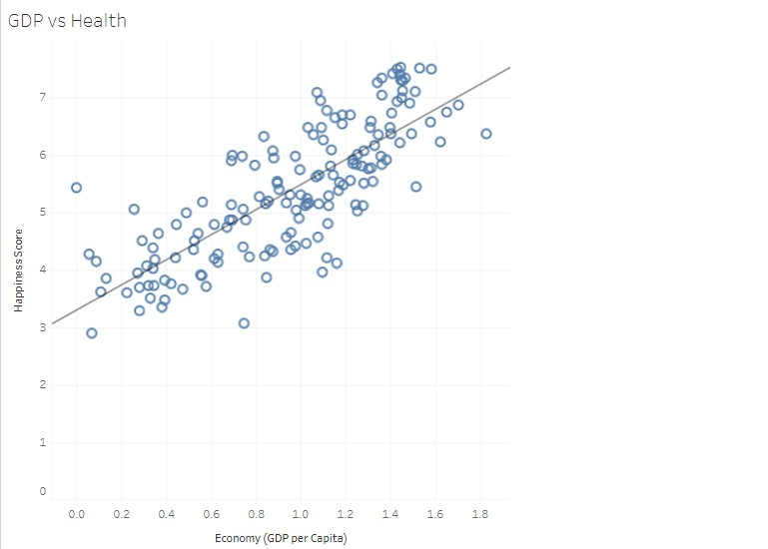
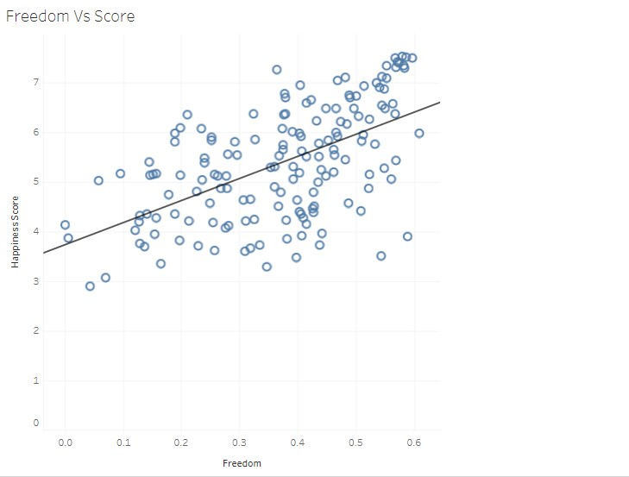
0.80
Correlation coefficient
Wealth
Strong correlation between GDP and Health
Positive correlation between Freedom and Score
0.60
Correlation coefficient
Wealthier countries have higher happiness score

Slide 14

Conclusion
1
2
3
Richest Countries have higher than the average Happiness levels
Wealth highly indicates the factor of Happiness
Healthy countries they also tends to have higher happiness levels
Also the healthy countries tends to be sustainable growth
Health , Gross domestic product (GDP) , Freedom of a country are the main contributors of Happiness score

Slide 15
THANK YOU

